Slide 1
Introduction to Pandas - Python 103
Goal: Review concepts learned from Python 101 & 102, and introduce new concepts for data cleaning and exploration

Slide 2

What We’ll Cover Today
Python 101-102 Review
Introduction to Pandas
What we will be learning in Python 103
Key Resources

Slide 3
Python 101-102 Review

Slide 4
What are the container data types that we learned about?
Notes:
Lists, strings, tuples, and dictionaries

Slide 5
What were the two loops that we learned about?
Notes:
For loops and While loops

Slide 6
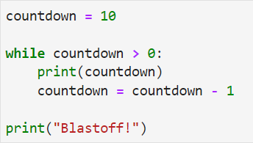
What will this code do?
Notes:
Answer on next slide…

Slide 7
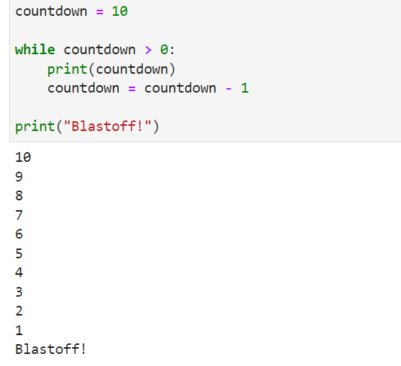

Slide 8
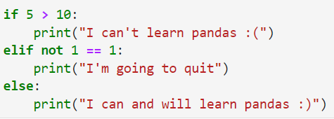
Which line will this code print?
Notes:
It will print “I can and will learn pandas :)” – You can have them put the answer in the chat as an affirmation and continue to the pandas intro

Slide 9
Intro to Pandas

Slide 10

What exactly is pandas?
pandas is a fast, powerful, flexible and easy to use open source data analysis and manipulation tool,
built on top of the Python programming language.

Slide 11
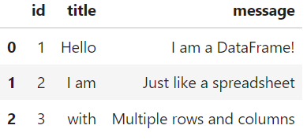
DataFrames are the new Spreadsheets
The main object that we work with in pandas is the DataFrame. It organizes data into a 2-dimensional container rows and columns, like a spreadsheet:

Slide 12
Series are the columns of a DataFrame
The other main data type in pandas is the Series
You can think of it as a column in a DataFrame
It holds the values of a particular column in a list-like container

Slide 13
What we will be learning in Python 103

Slide 14
Importing code libraries with the `import` statement
Up until now, we have written code using only the Python general library (that’s the code that Python comes with by default)
Real world code projects use external Python libraries, which can be thought of as extensions that we have to download and install to use
Once you have the library installed on your system, we need to import it into our code wherever we need it

Slide 15

The import statement
We don’t have to worry about downloading and installing pandas because that has already been taken care of for us.
All we need to do to use it in our code is import it:
We use the ‘import’ statement to say that we want to include an external library in our code. We then say the name of the library we want to import. The “as pd” part gives us an alias to use (“pd”) whenever we use pandas code. This is a general convention, so it’s a good idea to memorize this line.

Slide 16
Data Cleaning and Exploration
Like Excel and SQL, we can use pandas to explore and clean our data
Throughout our lesson, we will show you how pandas and SQL have very similar operations
There are a couple of functions that are good to know about for general data exploration (see next two slides)

Slide 17
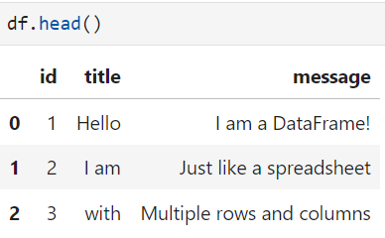
The ‘head’ function
Use the ‘head’ function to show you the first 5 rows and all the columns of your DataFrame:

Slide 18
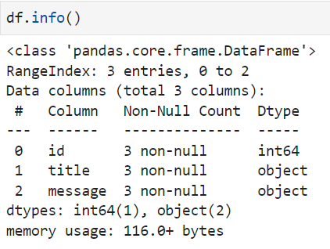
The ‘info’ function
Use the ‘info’ function to get some useful metadata from your DataFrame:
Notes:
Mention how ‘info’ provides information on the total number of columns and rows in the DataFrame, as well as the data types of the columns and even how much space the DataFrame takes in memory

Slide 19
Key Resources

Slide 20
Pandas Resources
Pandas Documentation
W3 Schools
DataCamp Pandas Cheat Sheet for Data Science
Use these as a reference as we go through the rest of the Python courses!

Slide 21
Let’s get back to coding!

